Slide 1
EmporiUm Sales Analysis with Power BI
West Region
Ndifon Caleb Ndakina
Colorado
Jim Heck

Slide 2
Project Overview
This project focuses on Emporium, a retail bookstore company that sells a variety of products, including books, textbooks, technology accessories, art supplies, apparel, and stationery through both in-store and online channels.
Using sales data from 2022 to 2025, I cleaned, transformed, modeled, and analyzed the data in Power BI to evaluate business performance in the West region, which is managed by Jim Heck. The goal of this analysis was to identify sales trends, top-performing product categories, leading store locations, and the best-selling books while uncovering opportunities for business growth.

Slide 3
Data source
Store Sales – in-store transactions and revenue.
Online Sales – online transactions and revenue.
Products – product information, categories, and product details.
Book List – book titles and author names used for the top-selling books analysis.
Store Locations – store cities, states, and locations used for store performance and regional analysis.
Date Table – used for time-based analysis and sales trends from 2022–2025.
Management Team – regional managers, territories, and leadership information.

Slide 4
Identified tools
Power BI Desktop – for modeling, analysis, and creating visualizations.
Power Query Editor – for transforming and cleaning the raw data.
DAX (Data Analysis Expressions) – for creating measures, calculations,
Microsoft Excel – for reviewing and understanding the data source files before importing them into Power BI.
GitHub & Git Bash – for storing and managing project files and tracking project progress
Analysis Guide
What are the sales trends over time?
How do sales compare across categories?
How are sales distributed by state?
Which books and authors generate the highest sales (excluding textbooks)?

Slide 5
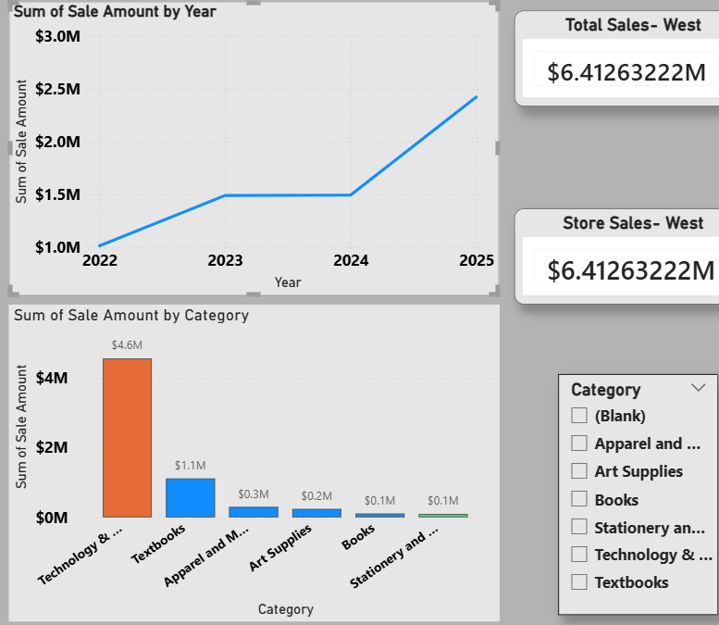
Question What are the sales trends over time? How do sales compare across categories?
This line chart shows the total sales for West region from 2022 to 2025. Sales increased from approximately $1.0 m in 2022 to $1.4 m in 2023, indicating strong growth. Revenue experienced a slight decline in 2024, dropping to about $1.3 million.
Despite a slight decline in 2024, sales revenue in the West region increased significantly from 2022 to 2025, reaching a peak of over $2.5 m in 2025.
Top Category Technology & Accessories: $4.6M
Median Category Art Supplies: $0.2M, representing the average category
Lowest Categories Books: $0.1M Stationery & Supplies: $0.1M

Slide 6
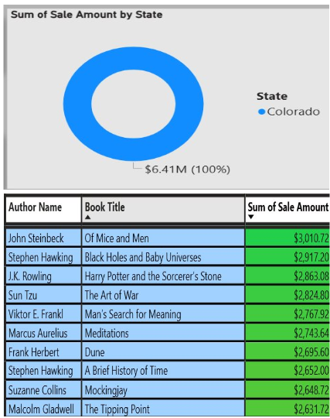
Questions How are sales distributed by state? Which books and authors generate the highest sales (excluding textbooks)?
This donut chart shows the distribution of total sales by state in the West region, which is based in Colorado, the chart shows that Colorado generated 100% of the region’s sales, with total revenue of approximately $6.41 million, call the trading period of 2022 to 2025.
This table shows the top-selling books in the West region, excluding textbooks. The books are ranked by total sales amount, allowing us to identify the most popular titles and authors among customers.
Best-Selling Book Of Mice and Men — John Steinbeck Sales: $3,010.72 Lowest-Selling Book (in the Top 10 List) The Tipping Point — Malcolm Gladwell Sales: $2,631.72

Slide 7
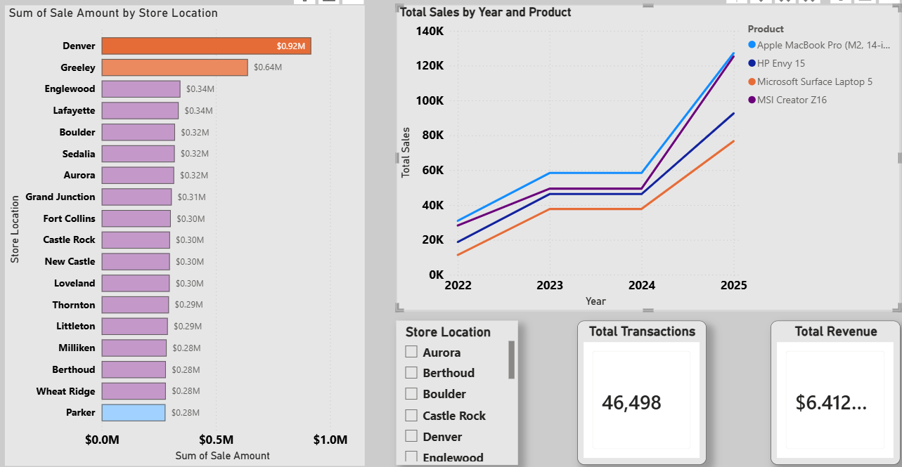
Comparing total revenue by store and top five product categories
Top 2 Performing Stores Denver — $0.92M Greeley — $0.64M
Denver is the highest-performing store, generating nearly $1 million in sales. Greeley ranks second and is significantly ahead of the remaining stores
Bottom 2 Performing Stores Parker — $0.28M Wheat Ridge — $0.28M
Parker recorded the lowest sales among all stores, while Wheat Ridge was the second-lowest performer. These locations may require additional marketing efforts increase revenue
In the Top5-Performing Products, Apple MacBook Pro M2 14 is Highest-selling product overall with Approximately $125,000 2025
MSI Creator Z16 is the least in the top5 with Approximately $85,0002025 Sales:

Slide 8


Microsoft Power BI

Slide 9
Recommendations for future growth
Based on my analysis, I recommend that Emporium continue investing in high-performing categories such as Technology & Accessories, as they generate the highest sales. I also recommend implementing targeted promotions and marketing strategies to improve sales in lower-performing categories and store locations.
Finally, leveraging best-selling books through featured displays and promotional campaigns can help attract more customers and increase revenue. I believe these strategies will help sustain sales growth and improve overall business performance in the next quarter.

Slide 10
Git hub Repository
Thank You For Your time
You can visit my Git Hub Repository for more insight on EmporiUm west Region
https://github.com/kalie-on/Capstone_3.git

